Slide 1
The Java Language

Slide 2
Why was Java created?
The primary motivation was the need for a platform independent language that could be used to create a s/w to be embedded in various consumer electronic devices.
But here different types of CPUs were used as controllers.
It is possible to compile a C/C++ program for any type of CPU but it requires a full C/C++ compiler for that CPU, which were expensive and time consuming.
To find a solution Java was developed which was portable, platform independent and could run on variety of CPU’s under differing environments.

Slide 3
Creation of Java
Java was conceived by James Gosling, Patrick Naughton, Chris Warth, Ed Frank and Mike Sheridan at Sun Microsystems in 1991.
The language was initially called ‘Oak’ (Oak is a symbol of strength and chosen as a national tree of many countries like U.S.A., France, Germany, Romania etc.) but was renamed ‘Java’ in 1995.

Slide 4
Why had they chosen java name for java language?
The team gathered to choose a new name. The suggested words were "dynamic", "java", "revolutionary", "Silk", "jolt", "DNA" etc. They wanted something that reflected the essence of the technology: revolutionary, dynamic, lively, cool, unique, and easy to spell and fun to say.
According to James Gosling "Java was one of the top choices along with Silk". Since java was so unique, most of the team members preferred java.

Slide 5
Java Programs
There are many types of Java programs which run differently:
Java Applet - small program written in Java and that is downloaded from a website and executed within a web browser on a client computer.
Application - executes on a client computer. If online, it has to be downloaded before being run.
JAR file (Java ARchive) - used to package Java files together into a single file (almost exactly like a .zip file).
Servlet - runs on a web server and helps to generate web pages.
Swing application - used to build an application that has a GUI (windows, buttons, menus, etc.).
EJB - runs on a web server and is used to develop large, complex websites.

Slide 6
Why Java is secure and portable?
The output of a java compiler(javac) is a .class file
It consists of bytecode (not native code)
It can be executed on any operating system(Windows, Unix etc.) that has JVM installed in it
When bytecode is executed on multiple platforms, JVM checks for the presence of virus or any malicious content that could hamper the system

Slide 7
Java Bytecode and JVM
It is a highly set of optimized instructions designed to be executed by the java runtime system called as JVM(Java Virtual machine)
JVM was designed as an interpreter for bytecode
Only the JVM needs to be implemented for each platform
JVM is platform dependent

Slide 9
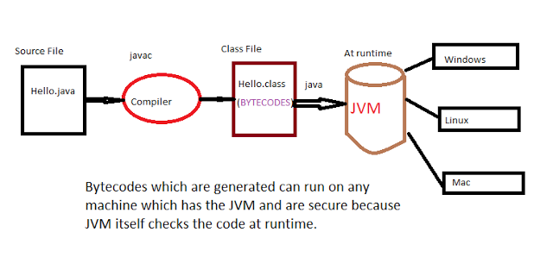

Slide 10
Java Runtime Environment(JRE)
JRE is an acronym for Java Runtime Environment.
It is used to provide runtime environment.
It is the implementation of JVM.
It contains set of libraries + other files that JVM uses at runtime.

Slide 11
Java Development Kit(JDK)
JDK is an acronym for Java Development Kit.
It contains JRE + development tools.

Slide 12
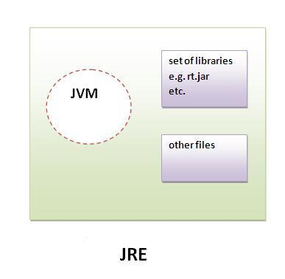
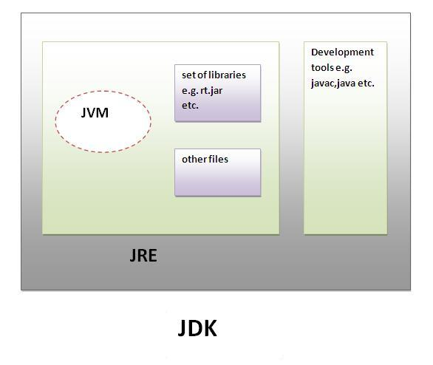

Slide 13
Features of Java
Simple
Syntax is based on C/C++
No pointers, operator overloading, multiple inheritance etc
No need to remove unreferenced objects because there is automatic garbage collection
Object-Oriented
Follows object-oriented concept
OOP’s model is simple and easy to extend

Slide 14
Platform Independent
Java code can be run on multiple platforms eg: Windows, Linux, Sun Solaris, MacOS

Slide 15
Secured
No explicit pointers
Java programs run inside JVM

Slide 16
Robust
Robust means strong
Java uses strong memory management ie;
Lack of pointers, automatic garbage collection, exception handling, strong type checking mechanism
All these makes java robust

Slide 17
Architecture neutral
Size of primitive types is fixed ie;
In C programming, int data type occupies 2 bytes of memory for 32-bit architecture and 4 bytes of memory for 64-bit architecture. But in java, it occupies 4 bytes of memory for both 32 and 64 bit architectures.
Portable
Distributed
We can create distributed applications in java. RMI and EJB is used for creating distributed applications. We may access files by calling the methods from any machine on the internet.
Multithreading
We can write Java programs that deal with many tasks at once by defining multiple threads
Threads are important for multi-media, Web applications etc.

Slide 18
First Simple Program
class Example{
public static void main(String args[]){
System.out.println(“This is a simple java program”);
}
}
This file is Example.java
By convention the name of the file should match with the name of the main class
String args[] declares a parameter named args which is an array of instances of class String
System is the class in java.lang package
out is the instance of java.io.PrintStream class
println is the method of java.io.PrintStream class
(PrintStream class object is created in System class)

Slide 19
Java Program Structure
Documentation Section
Package Statement
Import Statements
Interface Statements
Class Definitions
Main method class{ Main method definition }

Slide 20
Documentation section – It comprises a set of comment lines giving name of program, author and other details which the programmer would like to refer to at a later stage.
Package statement – This statement declares a package name and informs the compiler that the classes defined here belong to this package. Eg: package student;
Import statements - this is similar #include statement in C. eg: import student.test; we can have access to classes that are part of other packages
Interface statement – An interface is like a class but has only method declarations and final fields
Class definitions – A java program can have multiple class definitions
Main method class – Every java standalone programs require a main method which is the starting point of the program

Slide 21
Java Tokens
Smallest individual unit in a program are known as tokens.
Java has 5 types of tokens
Reserved keywords – there are 50 keywords currently defined. Eg: abstract, byte, class etc.
Identifiers – Identifiers are used to name things such as classes, variables and methods. Java is case-sensitive. So VALUE is different from value. Eg:AvgTemp,count,a4,this_is_ok etc.
Literals – A constant value in java is created by using a literal representation. Eg: 100, 98.6, ’X’, ”This is a test” etc.
Operators – An operator is a symbol that takes one or more arguments and operates on them to produce a result
Separators – Separators are symbols used to indicate where groups of code are divided and arranged. Eg: parenthesis(), braces{}, brackets[], semicolon; , comma , period .

Slide 22
Variables
Variable is name of reserved area allocated in memory
type identifier[=value], identifier[=value],…];
Eg: int a,b,c;
  int d=3,e,f=6;
  char x=‘x’;

Slide 24
1) Local Variable
A variable which is declared inside the method is called local variable.
2) Instance Variable
A variable which is declared inside the class but outside the method, is called instance variable . It is not declared as static.
3) Static variable
A variable that is declared as static is called static variable. It cannot be local.
class A{
int data=50;//instance variable
static int m=100;//static variable
void method(){
int n=90;//local variable
}
}//end of class

Slide 25
Data types
There are 2 data types available in Java
Primitive data types
Reference/Object data types
Java defines 8 primitive data types and they are put in 4 groups:
Integers : This group include byte, short, int and long which are whole valued signed numbers
Floating point numbers : This group include float and double which represent numbers with fractional precision
Characters : This group include char, which represents symbols in a character set like letters and numbers
Boolean : This group includes boolean which is used for representing true/false values

Slide 26
Type | Size | Range
byte | One byte | -128 to 127
short | Two bytes | -32768 to 32767
int | Four bytes | -2,147,483,648 to 2,147,483,647
long | Eight bytes | -9,223,372,036,854,775,808 to 9,223,372,036,854,775,807
We can make integers long by appending the letter L or l at the end of the number
123L or 123l

Slide 27
Floating point types – floating point types also known as real numbers are used when evaluating expressions that require fractional precision
There are 2 types :float and double
Floating point constants have a default type of double
float x=7.56//gives error
float x=7.56F
float is useful when you need a fractional component, but don’t require a large degree of precision
Math functions such as sin,cos,sqrt return double values. When you need to maintain accuracy over iterative calculations or manipulate large valued numbers double is the best choice
Type | Size | Range
float | 4 bytes | 1.4e-045 to 3.4e+038
double | 8 bytes | 4.9e-324 to 1.8e+308

Slide 28
Character type – the data type used to store characters is char.
char is 2 bytes
It uses Unicode to represent characters
Boolean type is used when we want to test a particular condition during the execution of the program. It can take only one of 2 possible values, true or false

Slide 29
Type casting
It is fairly common to assign a value of one type to a variable of another type. The process of converting one data type variable to another is called casting.

Slide 30
Widening or Automatic Type Conversion or Implicit Conversion
Widening conversion takes place when two data types are automatically converted. This happens when:
The two data types are compatible.
When we assign value of a smaller data type to a bigger data type.
Eg: byte b =75;
int a = b;
For Example, in java the numeric data types are compatible with each other but no automatic conversion is supported from numeric type to char or boolean. Also, char and boolean are not compatible with each other.

Slide 31
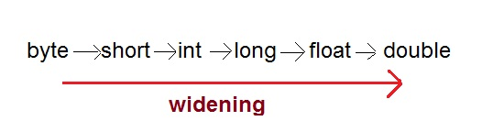
class Test { public static void main(String[] args) { int i = 100; //automatic type conversion long l = i; //automatic type conversion float f = l; System.out.println("Int value "+i); System.out.println("Long value "+l); System.out.println("Float value "+f); } }

Slide 32
Casting that results in no loss of information
From | To
byte | short, char, int, long, double
short | int, long, float, double
char | int, long, float, double
int | long, float, double
long | float, double
float | double

Slide 33
Narrowing or Explicit Conversion
If we want to assign a value of larger data type to a smaller data type we perform explicit type casting or narrowing.
This is useful for incompatible data types where automatic conversion cannot be done.
Here, target-type specifies the desired type to convert the specified value to.
Eg: int m=257;
  byte b;
  b = (byte) m; //(target type)value;
  This is also called as narrowing conversion since we are explicitly making the value narrower so that it will fit into the target type
  Casting into smaller type may result in loss of data

Slide 34
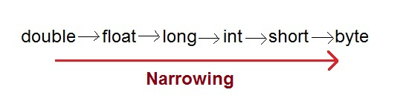
//Java program to illustrate incompatible data // type for explicit type conversion public class Test { public static void main(String[] argv) { char ch = 'c'; int num = 88; ch = num; } }

Slide 35
class Test { public static void main(String args[]) { byte b; int i = 257; double d = 323.142; System.out.println("Conversion of int to byte."); //i%256 b = (byte) i; System.out.println("i = b " + i + " b = " + b); System.out.println("\nConversion of double to byte."); //d%256 b = (byte) d; System.out.println("d = " + d + " b= " + b); } }

Slide 36
Java Statements
A Java statement is an instruction. That is, it tells Java what to do. All statements must end in a semicolon (;). This tells Java that it should attempt to process all information up to that semicolon.
Statements in Java can be broadly classified into three categories:
Declaration statement
Expression statement
Control flow statement
A declaration statement is used to declare a variable. For example,
int num;
int num2 = 100;
String str;

Slide 37
An expression with a semicolon at the end is called an expression statement. For example,
/Increment and decrement expressions
num++;
++num;
num--;
--num;
//Assignment expressions
num = 100;
num *= 10;
//Method invocation expressions
System.out.println("This is a statement");
someMethod(param1, param2);
Control flow statement
If block, while loop and for loop statements are examples of control flow statements.

Slide 38
Operators in Java
Operator in java is a symbol that is used to perform operations. For example: +, -, *, / etc.
There are many types of operators in java which are given below:
Unary Operator,
Arithmetic Operator,
Shift Operator,
Relational Operator,
Bitwise Operator,
Logical Operator,
Ternary Operator and
Assignment Operator

Slide 39
 | Java Operator precedence
Operator Type | Category | Precedence
Unary | postfix | expr++ expr--
 | prefix | ++expr --expr +expr -expr ~ !
Arithmetic | multiplicative | * / %
 | additive | + -
Shift | shift | << >> >>>
Relational | comparison | < > <= >= instanceof
 | equality | == !=
Bitwise | bitwise AND | &
 | bitwise exclusive OR | ^
 | bitwise inclusive OR | |
Logical | logical AND | &&
 | logical OR | ||
Ternary | ternary | ? :
Assignment | assignment | = += -= *= /= %= &= ^= |= <<= >>= >>>=

Slide 40
Bitwise operator works on bits and performs bit-by-bit operation. Assume if a = 60 and b = 13; now in binary format they will be as follows −
a = 0011 1100
b = 0000 1101
-----------------
a&b = 0000 1100
a|b = 0011 1101
a^b = 0011 0001
~a = 1100 0011
a<<2=1111 0000
a>>2=0000 1111
a>>>2=0000 1111
The following table lists the bitwise operators −
Assume integer variable A holds 60 and variable B holds 13 then −

Slide 41
Special operators
Java supports some special operators such as instanceof operator and member selection operator(.)
instanceof is an object reference operator and returns true if the object on the left hand side is an instance of the class given on the right hand side
Eg: person instanceof student
returns true if the object person belongs to class student
person.age //reference to variable age
person.salary() //reference to method salary

Slide 42
Decision making and branching
The Java if statement is used to test the condition. It checks boolean condition: true or false. There are various types of if statement in java.
if statement
if-else statement
nested if statement
if-else-if ladder

Slide 43
Java If statement
The Java if statement tests the condition. It executes the if block if condition is true.
Syntax:
if(condition){
//code to be executed
}
public class IfExample {
public static void main(String[] args) {
int age=20;
if(age>18){
System.out.print("Age is greater than 18");
}
}
}

Slide 44
Java IF-else Statement
The Java if-else statement also tests the condition. It executes the if block if condition is true otherwise else block is executed.
Syntax:
if(condition){
//code if condition is true
}else{
//code if condition is false
}
public class IfElseExample {
public static void main(String[] args) {
int number=13;
if(number%2==0){
System.out.println("even number");
}else{
System.out.println("odd number");
}
}
}

Slide 45
Java IF-else-if ladder Statement
The if-else-if ladder statement executes one condition from multiple statements.
Syntax:
if(condition1){
//code to be executed if condition1 is true
}else if(condition2){
//code to be executed if condition2 is true
}
else if(condition3){
//code to be executed if condition3 is true
}
...
else{
//code to be executed if all the conditions are false
}

Slide 46
Java Switch Statement
The Java switch statement executes one statement from multiple conditions. It is like if-else-if ladder statement.
Syntax:
switch(expression){
case value1:
//code to be executed;
break; //optional
case value2:
//code to be executed;
break; //optional
......
default: //optional
code to be executed if all cases are not matched;
}
Statement – x;

Slide 47
The ?: operator(conditional operator)
Syntax :
conditional expression ? expression1 : expression 2
Eg: if(x<0)
flag=0;
else
flag=1;
can be written as
flag = (x<0) ? 0 : 1;
Another example
Consider the weekly sales of a sales girl who is selling some domestic products. If x is the number of products sold in a week, her weekly salary is given by
Salary = {4x+100 for x<40
{300 for x=40
{4.5x+150 for x>40
Salary = (x!=40) ? ((x<40) ? (4*x+100) : (4.5*x+150)) : 300;

Slide 48
Decision making and looping
A program loop consists of 2 segments :body of the loop and control statement
The control statement tests certain conditions and then directs the repeated execution of the statements contained in the body of the loop
Java provides 3 constructs for performing loop operations:
while construct
do construct
for construct

Slide 49
There are 2 forms of for loop. It is an entry controlled loop
for(initialization; condition; iteration){
//body
}

Slide 50
A second form of for was defined beginning with jdk 5. A for-each style loop is designed to cycle through a collection of objects
for(type itr-var : collection)statement-block
type specifies the type and itr-var specifies name of iteration variable that will receive elements from a collection, one at a time, from beginning to end
int nums[] = {1,2,3,4,5,6,7,8,9,10};
int sum = 0;
for(int i=0; i<10 ; i++)
sum+=nums[i];
//another way of writing
int nums[] = {1,2,3,4,5,6,7,8,9,10};
int sum = 0;
for(int x : nums)
sum+=x;

Slide 51
class forEachEx{
public static void main(String args[]){
char arr[]={'a','e','i','o','u'};
for(int i=0;i<5;i++){
System.out.println(arr[i]);
}
char arrForEach[]={'a','e','i','o','u'};
for(char a:arrForEach){
System.out.println(a);
}
}
}

Slide 52
while loop
The Java while loop is used to iterate a part of the program several times. If the number of iteration is not fixed, it is recommended to use while loop.
It is an entry controlled loop
Syntax:
while(condition){
//code to be executed
}

Slide 53
Java do-while Loop
The Java do-while loop is used to iterate a part of the program several times. If the number of iteration is not fixed and you must have to execute the loop at least once, it is recommended to use do-while loop.
It is an exit controlled loop
The Java do-while loop is executed at least once because condition is checked after loop body.
Syntax:
do{
//code to be executed
}while(condition);

Slide 54
Arrays
An array is a group of similar typed variables that are referred by a common name.
One-Dimensional Array
A list of items can be given one variable name using only one subscript and such a variable is called single subscripted variable or one dimensional array
Syntax:
type var-name[];
Eg: int month_days[];

Slide 55
Creating an array
Arrays must be declared and created before they can be used. There are 3 steps
Declaring the array
Creating memory locations
Putting values into memory locations

Slide 56
Arrays can be declared in 2 ways;
type arrayname[]; or type[] arrayname;
Eg: int number[];
  float average[];
  int[] counter;
  float[] marks;
  After declaring we need to create it in memory. It is done using new operator
  Eg: number=new int[4];
  average=new float[10];
  The final step is to initialize arrays or put values into the arrays created
  arrayname[subscript] = value;
  Eg: number[0]=35;
  number[1]=40;
  number[2]=20;
  number[3]=45;
  Arrays can be initialized when they are declared. There is no need to use new
  Or type arrayname[]={list of values};
  int number[] = {35,40,20,45};

Slide 57
It is possible to assign an array object to another
int a[] = {1,2,3};
int b[];
b=a;
Both the arrays have same values.
Loops may be used to initialize large size arrays.
for(int i=0;i<100;i++){
if(i<50)
Sum[i]=0.0;
else
Sum[i]=1.0;
}
Array length
Array length is obtained using variable named length
Eg: int aSize=a.length;
Where a is an array.

Slide 58
Two dimensional arrays
2D arrays are used where a table of values will have to be stored
Eg: int myArray[][];
myArray = new int[3][4];
Or
int myArray[][]=new int[3][4];
Or
int myArray[][]={{23,34,21,43},{50,43,27,65}, {38,57,49,30}};

Slide 59
Multidimensional arrays
Java treats multidimensional arrays as “arrays of arrays”.
It is possible to declare a 2D array as follows:
int x[][] = new int[3][];
x[0] = new int[2];
x[1] = new int[4];
x[2] = new int[3];

